Slide 1
STILIMI I TEKSTEVE
05

Slide 2
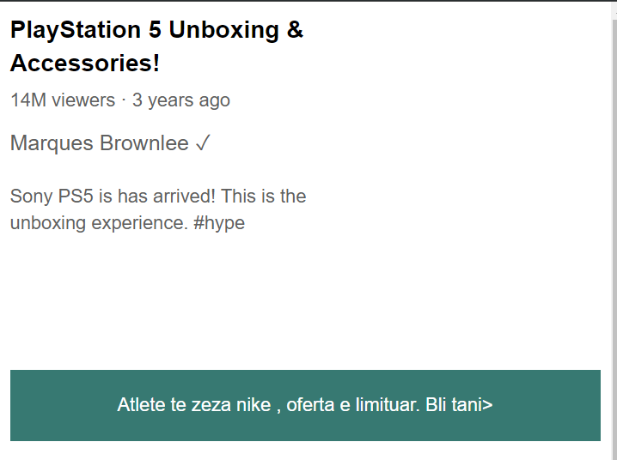
https://sabian01.github.io/leksioni05/tekste.html

Slide 3

WORD TOOLBAR

Slide 4
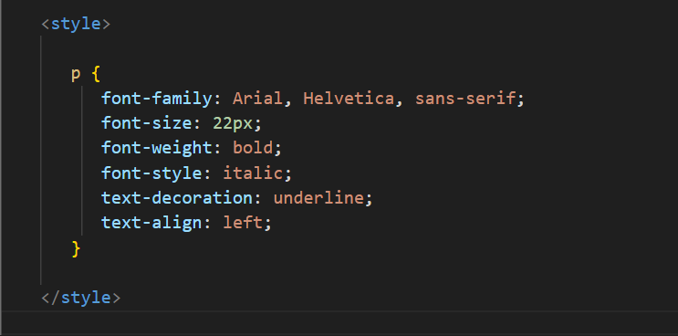
CSS

Slide 5
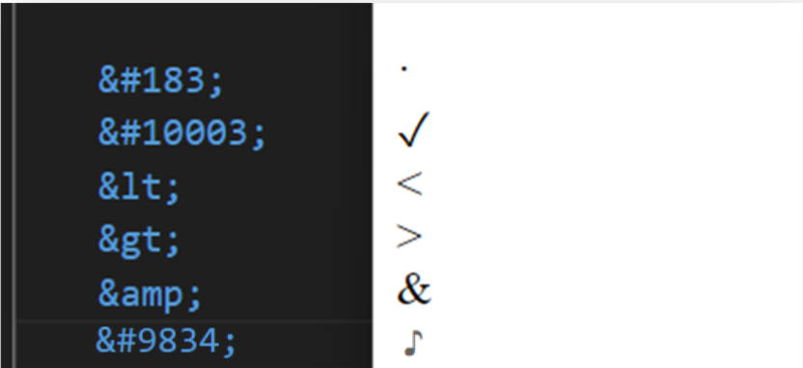
HTML ENTITIES

Slide 6
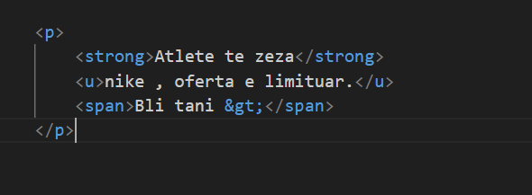
TAGE TE REJA

